Slide 1
NORTH WHIDBEY
LITTLE LEAGUE
⚾
COACHES & MANAGERS MEETING
SPRING 2026
Oak Harbor, Washington
Thank you for volunteering — YOU make the season possible!

Slide 2
WELCOME & INTRODUCTIONS
Let's meet the team behind the team
🏅
🎯
Board Members
Tonight's Goals
President
Vice Presidents
Treasurer
Safety
Player Agent
Field and Equip Manager
Umpire in Charge
Information Officer
Introductions
Timelines
Expectations
Rules and Safety
Coaching resources
Q/A
northwhidbeylittleleague.org | info@northwhidbeylittleleague.org | Spring 2026

Slide 3
LEAGUE OVERVIEW & 2026 SEASON TIMELINE
Key dates for coaches to know — Oak Harbor, Washington
Feb 15
Late Feb–
Mar
Mar 2
Apr 18
Also Picture day
Jun–Jul
Registration
Closed
Evaluations /
Tryouts
Practices
Begin
Opening
Day
All-Stars
MISSION: Provide a positive, fun, and developmental baseball/softball experience for all youth in the North Whidbey / Oak Harbor community.
northwhidbeylittleleague.org | info@northwhidbeylittleleague.org | Spring 2026

Slide 4

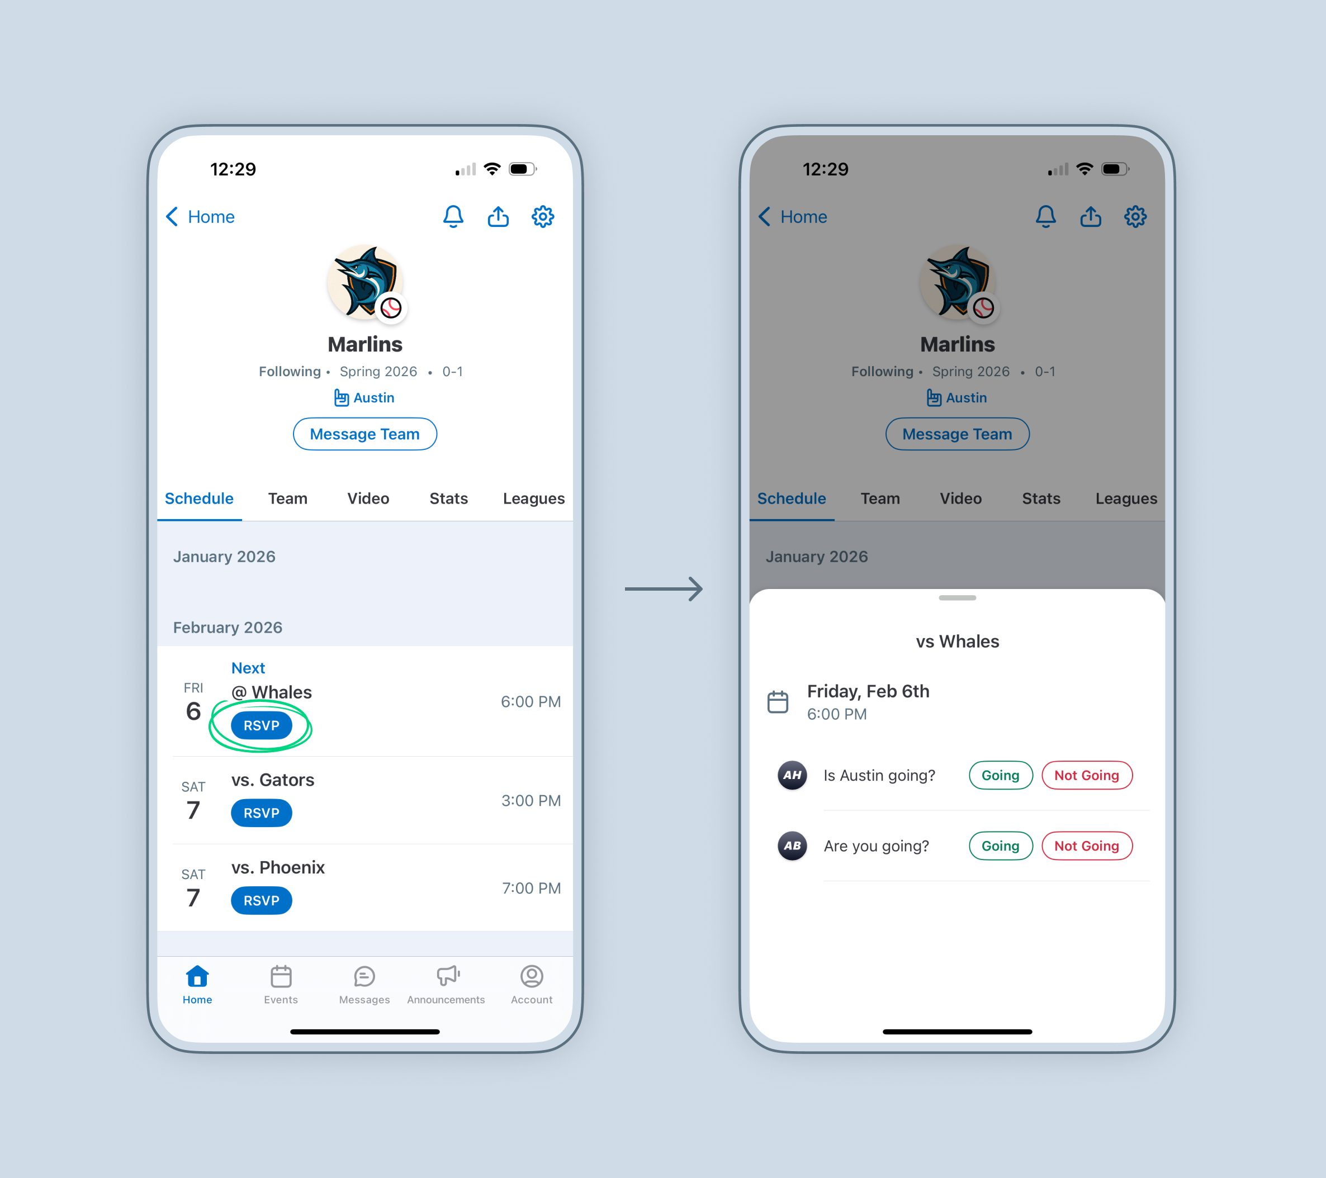
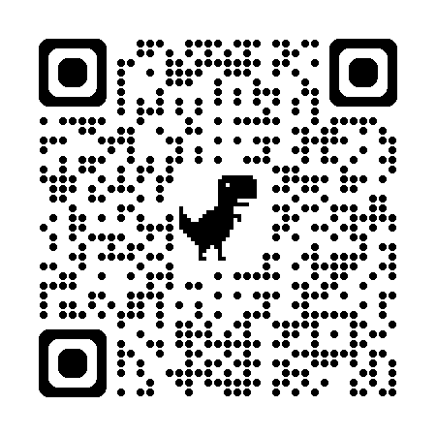
Communication Methods
Communication and supporting the league are our biggest priorities
GC.com
Sports Connect Email
You do not have to pay!
Option is there
northwhidbeylittleleague.org | info@northwhidbeylittleleague.org | Spring 2026

Slide 5
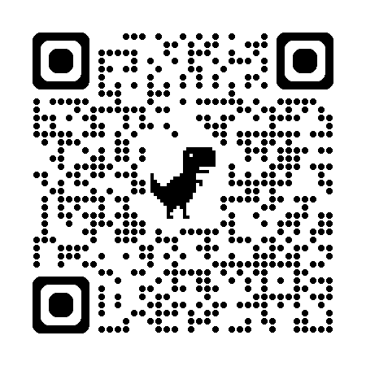
LITTLE LEAGUE RULES — 2026 HIGHLIGHTS
Know these before the first pitch
⚾ Pitch Counts are mandatory
🏏 USA Baseball / USABat stamp / 1.20 BPF sticker
❌ Metal Cleats (T-ball, Rookie, Minors)
🏃 Head First Slides (Majors & Below)
Rules Clinic at Anacortes Firehouse
Softball: 14 March
Baseball: 21 March
📋 Local NWLL bylaws:
Playing Time Minimums
Batting Order Rules
❓ Rule questions? Contact via GameChanger or Email
coach@northwhidbeylittleleague.org
playeragent@northwhidbeylittleleague.org
vpbaseball@northwhidbeylittleleague.org
vpsoftball@northwhidbeylittleleague.org
northwhidbeylittleleague.org | info@northwhidbeylittleleague.org | Spring 2026

Slide 6
⚾ BASEBALL PITCHING RULES — PITCH COUNTS & REST
Official Little League Regulation VI — Regular Season | Ages 6–16
DAILY PITCH LIMITS (by League Age)
REST DAYS REQUIRED — Ages 14 & Under
Ages 6–8
50 pitches / day
Ages 14 & Under — Pitches → Rest Days
1–20 pitches
0 days
Ages 9–10
75 pitches / day
21–35 pitches
1 day
Ages 11–12
85 pitches / day
36–50 pitches
2 days
51–65 pitches
3 days
Ages 13–16
95 pitches / day
66+ pitches
4 days
⚠️ CATCHER RULE
Ages 15–16 — Pitches → Rest Days
Caught 4+ innings = cannot pitch that day. Threw 41+ pitches = cannot catch the rest of that day.
1–30 → 0 days
61–75 → 3 days
31–45 → 1 day
76+ → 4 days
46–60 → 2 days
northwhidbeylittleleague.org | info@northwhidbeylittleleague.org | Spring 2026
🚫 No pitcher may pitch 3 consecutive calendar days — ever.

Slide 7
🥎 SOFTBALL PITCHING RULES — INNINGS & REST DAYS
Official Little League Softball Regulation — Regular Season | Innings-based (not pitch count)
KEY DIFFERENCE: Softball tracks INNINGS PITCHED — not pitch counts. Throwing even one pitch in an inning counts as pitching that full inning.
DAILY INNING LIMITS
REST DAYS — Minors & Majors
Minor Softball
12 innings max / day
1 – 6 innings
0 days rest
Majors Softball
12 innings max / day
7+ innings
1 day rest
Junior Softball
12 innings max / day
12 innings
Daily max
Senior Softball
12 innings max / day
⚠️ 1 pitch in an inning = 1 full inning pitched for rest purposes.
Junior/Senior only: A pitcher removed may return as pitcher once per game. In Minors/Majors, once removed — they may NOT return as pitcher.
🚫 No pitcher may pitch in 3 consecutive calendar days. | Source: LittleLeague.org/playing-rules/pitch-count
northwhidbeylittleleague.org | info@northwhidbeylittleleague.org | Spring 2026

Slide 8
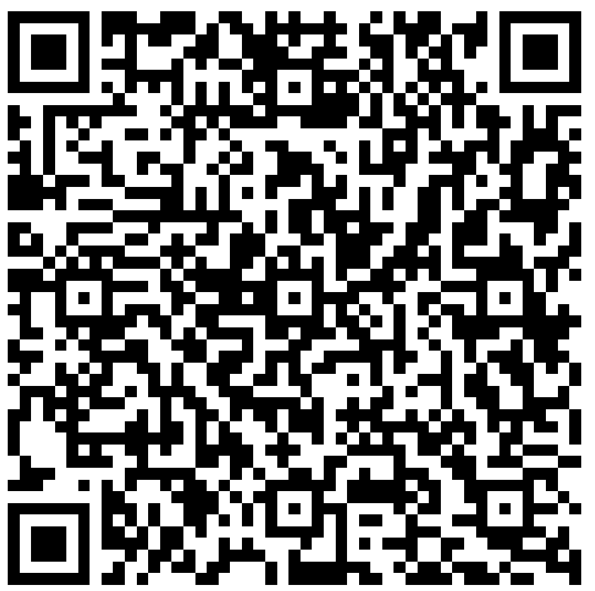
⛑ SAFETY FIRST — ASAP PLAN
Little League's A Safety Awareness Program — required for all teams
✅
Background Checks
🩺
First-Aid Kit
🧠
Concussion Protocol
Mandatory for ALL volunteers before coaching begins.
Bring one to every practice and game. Know its location.
Know the signs. When in doubt, sit them out.
🌡️
Heat & Weather
📋
Incident Reporting
🔍
Equipment Checks
Monitor conditions. Postpone if unsafe — check league comms.
Report all injuries to the Safety Officer immediately.
Inspect helmets, bats, and catcher's gear before every game.
northwhidbeylittleleague.org | info@northwhidbeylittleleague.org | Spring 2026

Slide 9
COACHING PHILOSOPHY & EXPECTATIONS
Fun, fundamentals, sportsmanship — in that order
"It's not whether you win or lose — it's how you develop the love of the game."
⚾ Tee Ball
⚾ Rookie / Minor
⚾ Majors / Junior
Basics of throwing & catching
Running the bases
Smiles — always!
Fundamentals & field positions
Game rules & conduct
Teamwork & sportsmanship
Pitching mechanics & pitch counts
Strategy & situational play
Competitive development
northwhidbeylittleleague.org | info@northwhidbeylittleleague.org | Spring 2026

Slide 10
PRACTICE & GAME DAY TIPS
Prepare, engage, inspire
🏋️ PRACTICE
⚾ GAME DAY
Keep it 60–90 min and high energy
Use stations: hitting, fielding, base running, games
Free drills at LittleLeague.org & Little League University on YouTube
Include fun! Scrimmages, competitions, water breaks
Share schedule with parents at least 1 week ahead
Arrive 45–60 min early for warm-up & equipment check
Prepare the fields
Chalk and spray lines
Field Meeting 7 MAR
Lineup, coin toss, ground rules before first pitch
Rotate positions — no kid stuck in one spot all season
Post-game huddle: highlight effort, one teaching point
Respect umpires — model sportsmanship for players & parents
northwhidbeylittleleague.org | info@northwhidbeylittleleague.org | Spring 2026

Slide 11
PARENT COMMUNICATION & TEAM MANAGEMENT
Set expectations early — keep it positive
1
Hold a Parent Meeting — Week 1 —
Cover your philosophy, schedule, playing time expectations, and sideline behavior. Get ahead of issues early.
2
Use a Team App —
GameChanger or TeamSnap group chat for schedules, cancellations, and updates. Parents need reliable info fast.
3
Recruit Help —
Team parent for snacks/drinks, scorekeeper, field prep volunteer. Share the load.
4
Code of Conduct —
Parents cheer positively. No sideline coaching or shouting instructions. Kids play for the coaches, not the bleachers.
5
Handle Issues Privately —
Direct parents to talk after the game, away from players. Keep the dugout a positive environment.
northwhidbeylittleleague.org | info@northwhidbeylittleleague.org | Spring 2026

Slide 12
EQUIPMENT, UNIFORMS & RESOURCES
Everything you need to know before Opening Day
🏟️ LEAGUE PROVIDES
📚 RESOURCES & LINKS
Game balls, bats, helmets bases, pitching rubber
Catcher's gear (full set per team)
Uniforms (Hat, Belt, Socks, shirt)— pickup details TBD by board
🌐
northwhidbeylittleleague.org
Rosters, schedules, bylaws, forms
📘
Facebook: @NorthWhidbeyLittleLeague
Announcements & updates
🎽 PLAYERS BRING
🎓
Little League University
Personal glove
Rubber cleats
Water bottle
Cups
Sunglasses
Free coaching videos & articles at LittleLeague.org
📧
info@northwhidbeylittleleague.org
Questions? Email us anytime
northwhidbeylittleleague.org | info@northwhidbeylittleleague.org | Spring 2026

Slide 13
NEXT STEPS & CLOSING
You're the heart of NWLL — thank you for everything you do.
🗓️ ROSTERS: Watch for board communications this week
👥 PARENT MEETING: Schedule yours in the first week of practice (Week of March 2 or March 8)
📋 BACKGROUND CHECKS: Must be complete before first practice — see Safety Officer
📱 TEAM APP: Set up GameChanger or group chat before practices begin
❓ QUESTIONS: Open floor — ask anything!
⚾ PLAY BALL! — Spring 2026 — northwhidbeylittleleague.org

